Slide 1
Machine Learning Project Ideas and Proposal
Under supervision of Dr. Soumitra Samanta
By:
Rajat Gaur
Krishnakanta Maity
Saikat Patra

Slide 2


Topic of Discussion
Idea Discussion
Problem Statement
Methodology
Implementation
Timeline

Slide 3

Data Description
Dataset is available in Mendeley dataset website (https://data.mendeley.com/datasets/rscbjbr9sj/3).
Datasetcontains thousands of validated OCT and Chest X-Ray images.
The images are split into a training set and a testing set of independent patients. Images are labelled as (disease)-(randomized patient ID)-(image number by this patient) and split into 4 directories: CNV, DME, DRUSEN, and NORMAL.

Slide 4

Ideas for Project Finalization
SPECT Imaging Analysis
Pneumonia Diagnosis via Chest X-Ray Images
Russia Vs Ukraine Twitter Sentiment Analysis

Slide 5

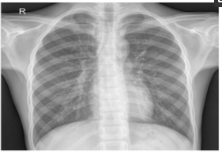
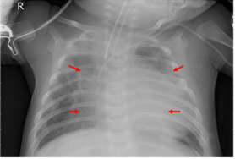
Finalizing Topic
Implementing machine learning and deep learning concepts to assess the feasibility of diagnosis of Pneumonia using chest X-Ray Images.
Pneumonia Diagnosis via Chest X-Ray Images

Slide 6

Methodology
Data Collection
Data Pre-processing
EDA and Handling Missing Values
Testing the Results
Cross Validation
Splitting Dataset - Train / Test
Coming up with Model & Training
Conclusion & Interpretation

Slide 7
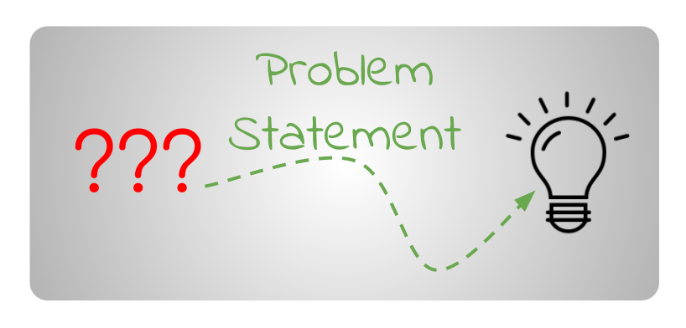




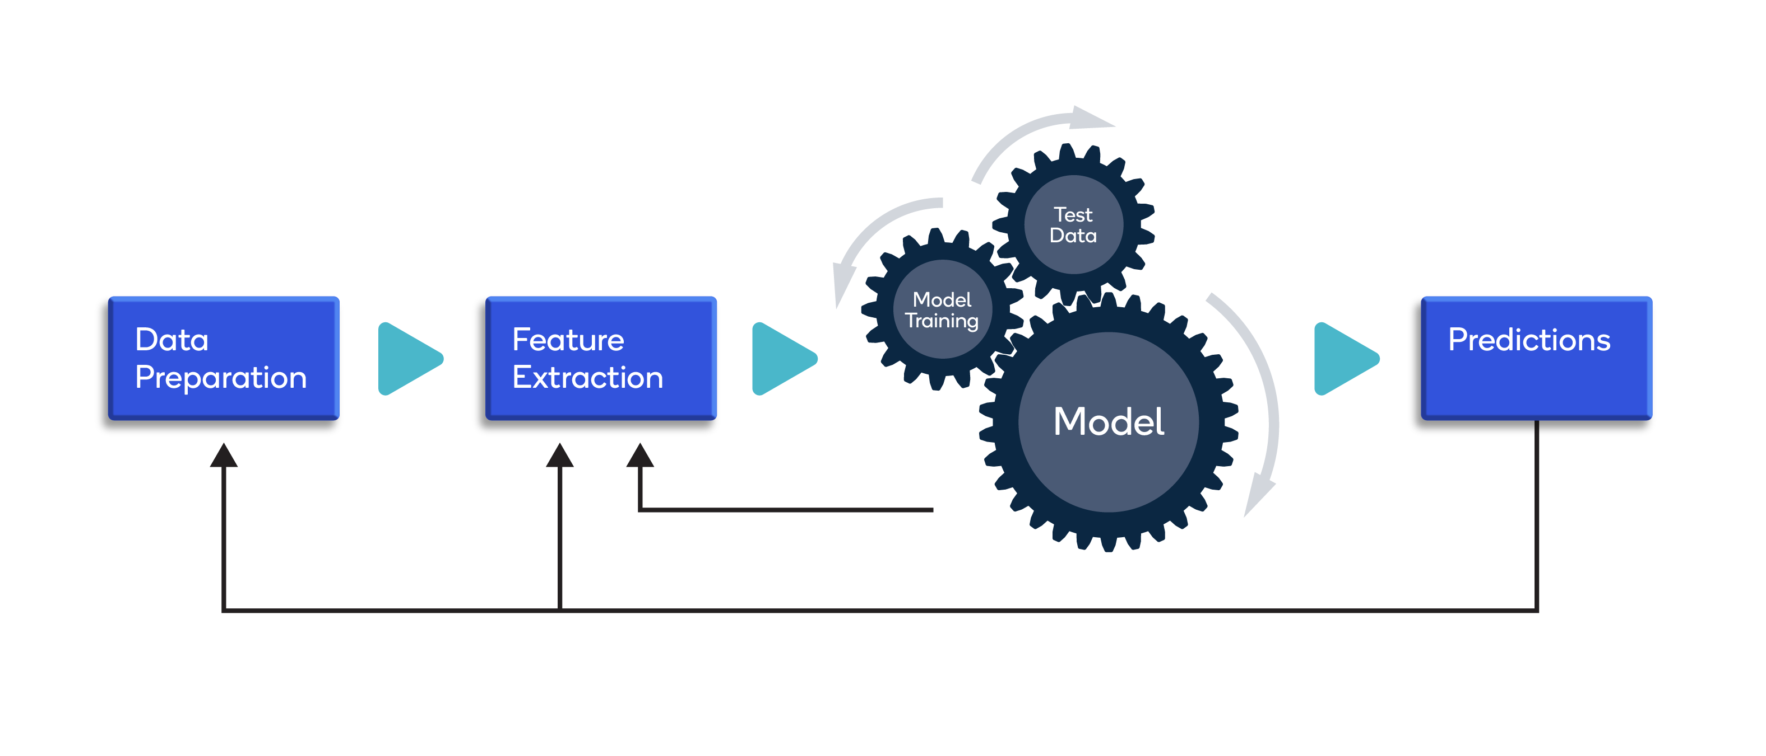

PROJECT TIMELINE
March Week 4
April Week 3,4
May Week 3,4
June Week 2
Finalizing the problem statement and project basis feedback given during presentation
Reading literature and finishing EDA to explore the dataset
Improving the model (basis scope) and interpreting the results
Presenting the project and briefing the result via PPT presentation
April Week 1,2
May Week 1,2
June Week 1
Data collection,
Data pre-processing,
and
Starting EDA
Model building,
Model Training,
Testing and evaluating matrices
Making inferences and writing the final report for submission

Slide 8
Thank You

